Slide 1
Introduction to Data Mining (COMP 4331)
Tutorial 2: Data Preprocessing
JIANG Weisen
wjiangar@connect.ust.hk
HKUST
2021 Sep. 17
Notebook on Google Colab
https://colab.research.google.com/drive/1UWlXju4wPgwD14WgcuvGPtpcw_MX5jKl?usp=sharing

Slide 2
Outline
Data Preparation: numpy, pandas
Data Summary (Statistical Description): pandas
Data Visualization: seaborn, matplotlib
Correlation and Independence: pandas
Data Transformation (Normalization and Discretization): sklearn

Slide 3


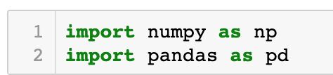
Data Preparation

Slide 4
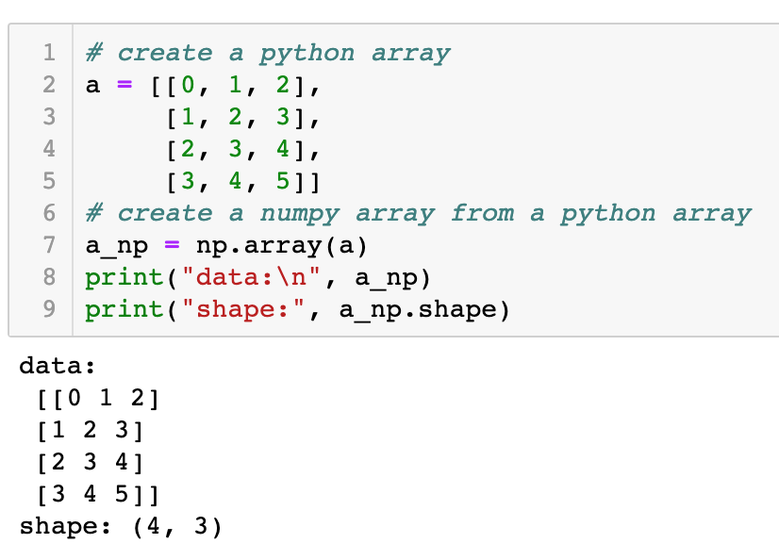
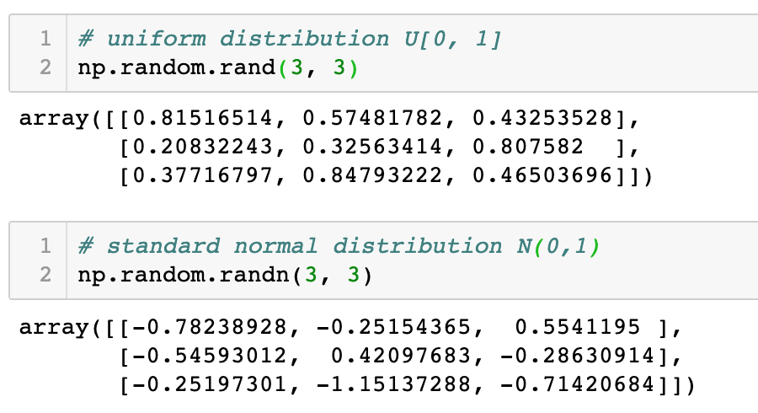
Numpy Array
numpy array ≈ “matrix”

Slide 5
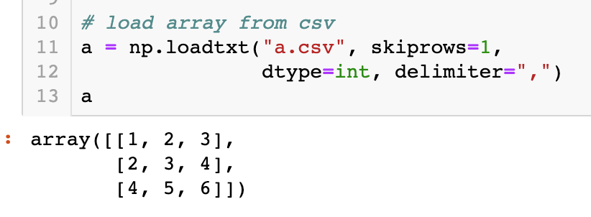
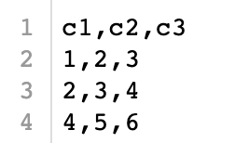
Numpy Array ...
a.csv

Slide 6
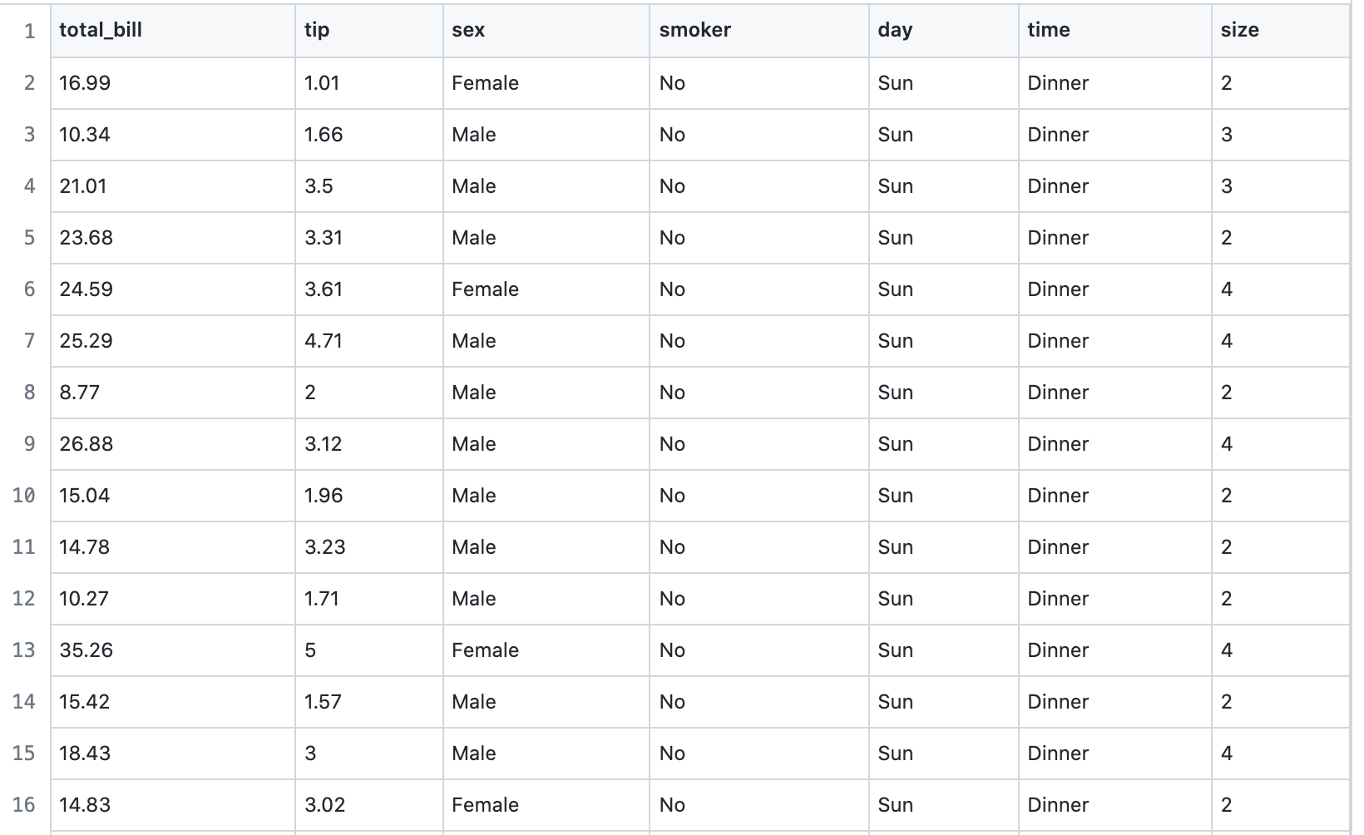
Tabular Data?
float
float
string
boolean
string
string
int
https://github.com/mwaskom/seaborn-data/blob/master/tips.csv

Slide 7
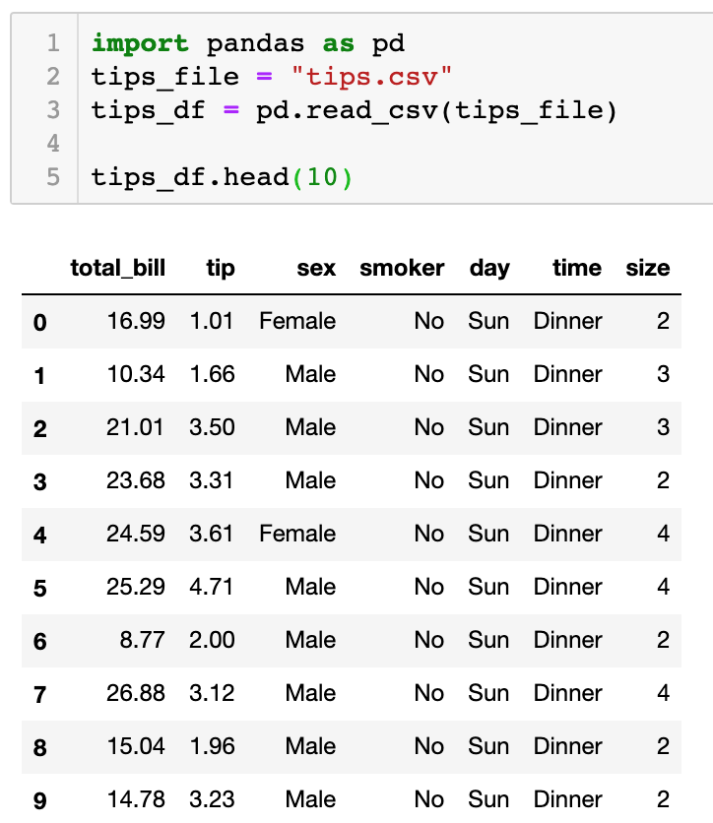
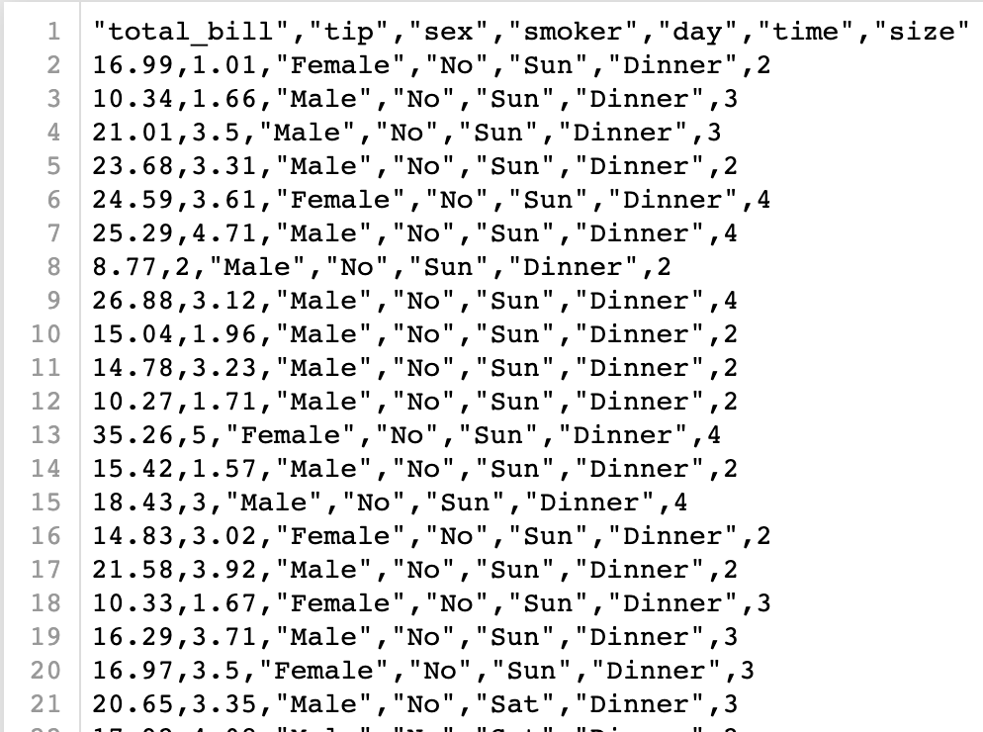
Pandas Dataframe
tips.csv

Slide 8
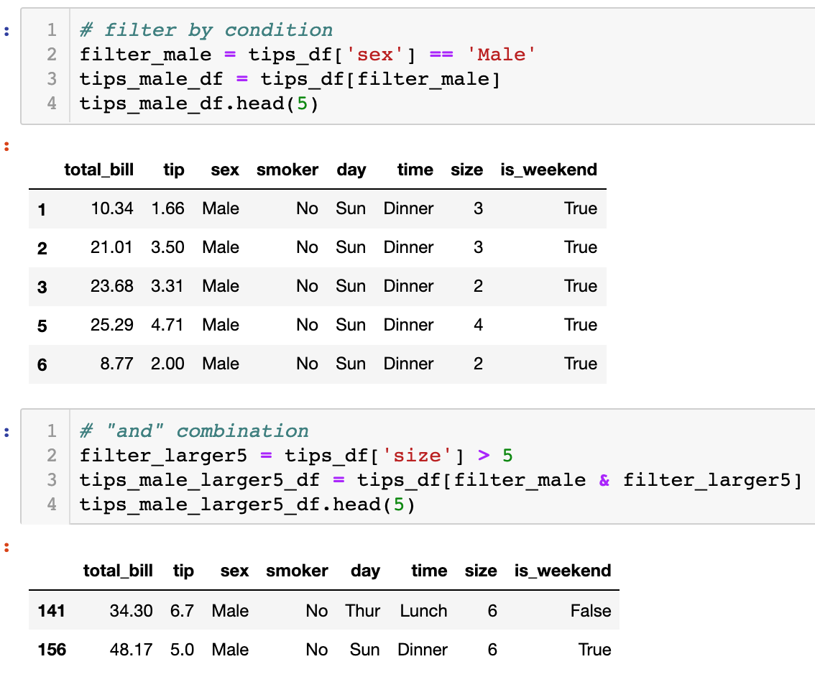
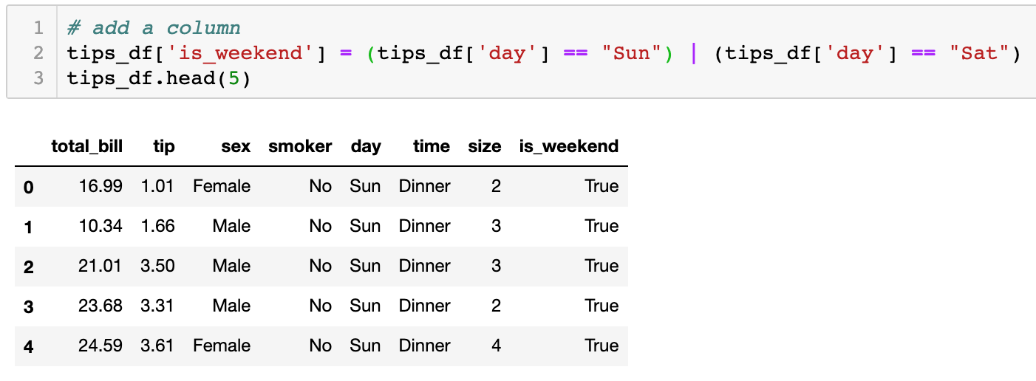
Dataframe ≈ “Table” in Excel or MySQL

Slide 9
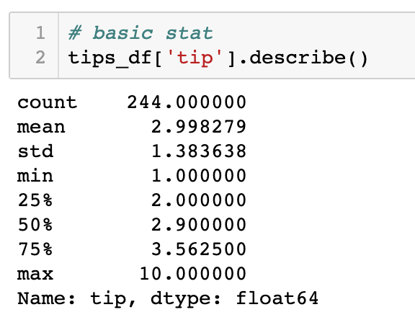
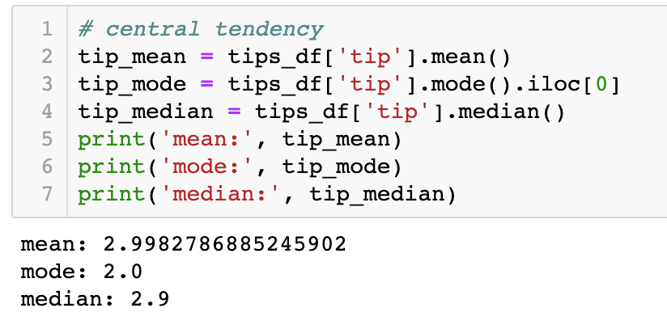
Data Summary: Statistical Descriptions
Dispersion
Central Tendency

Slide 10
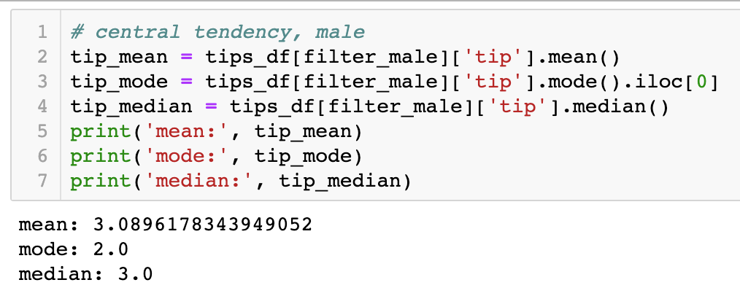
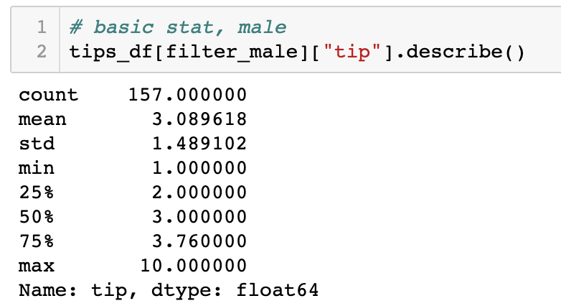
Data Summary: Statistical Descriptions ...

Slide 11
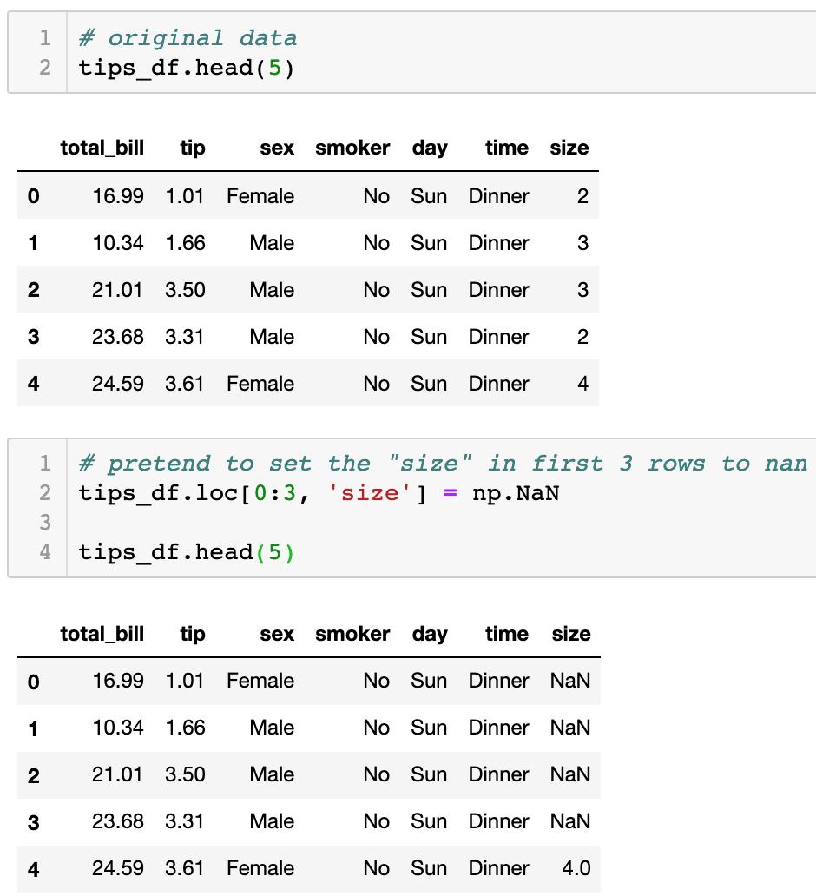
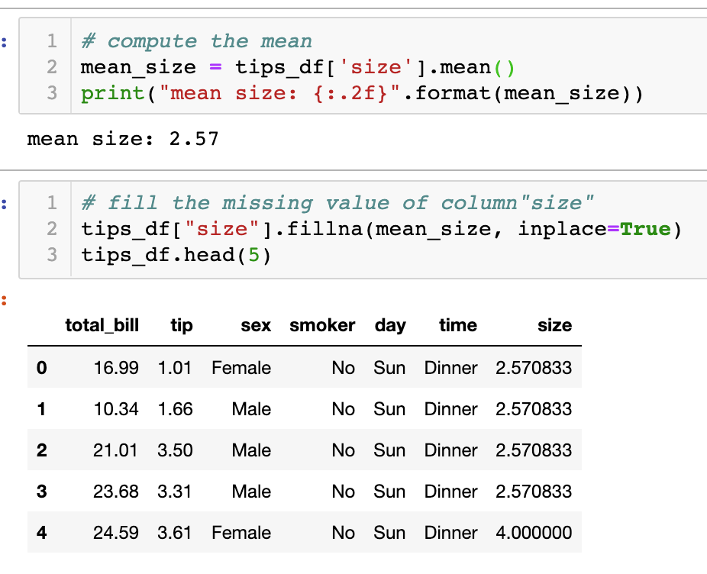
Missing Value

Slide 12



Data Visualization

Slide 13
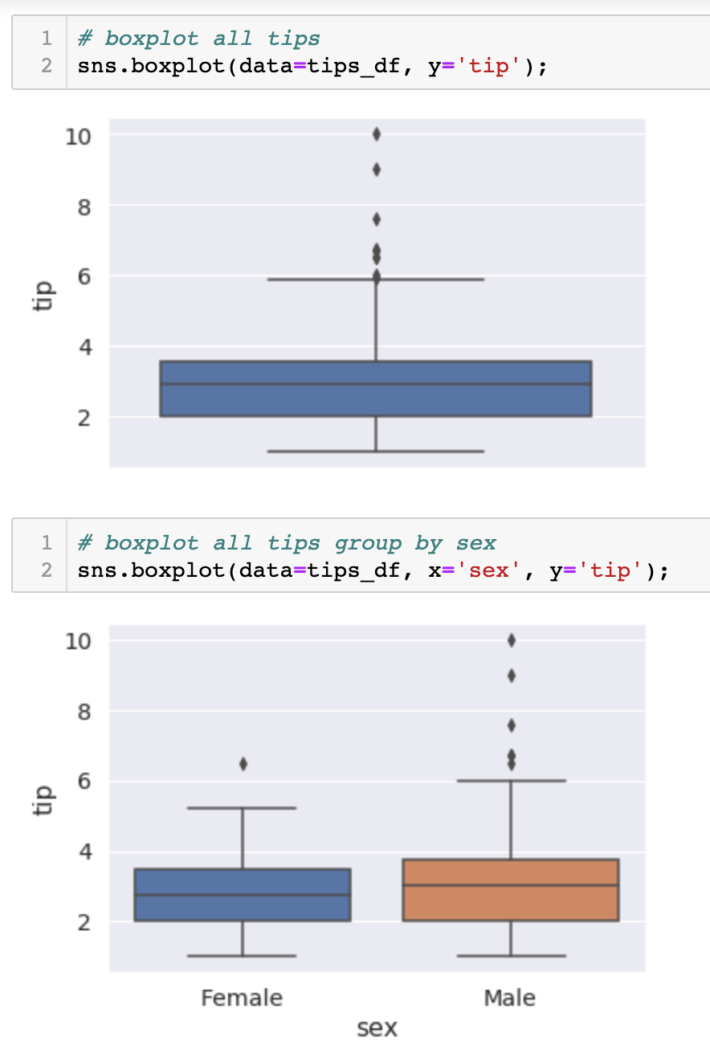
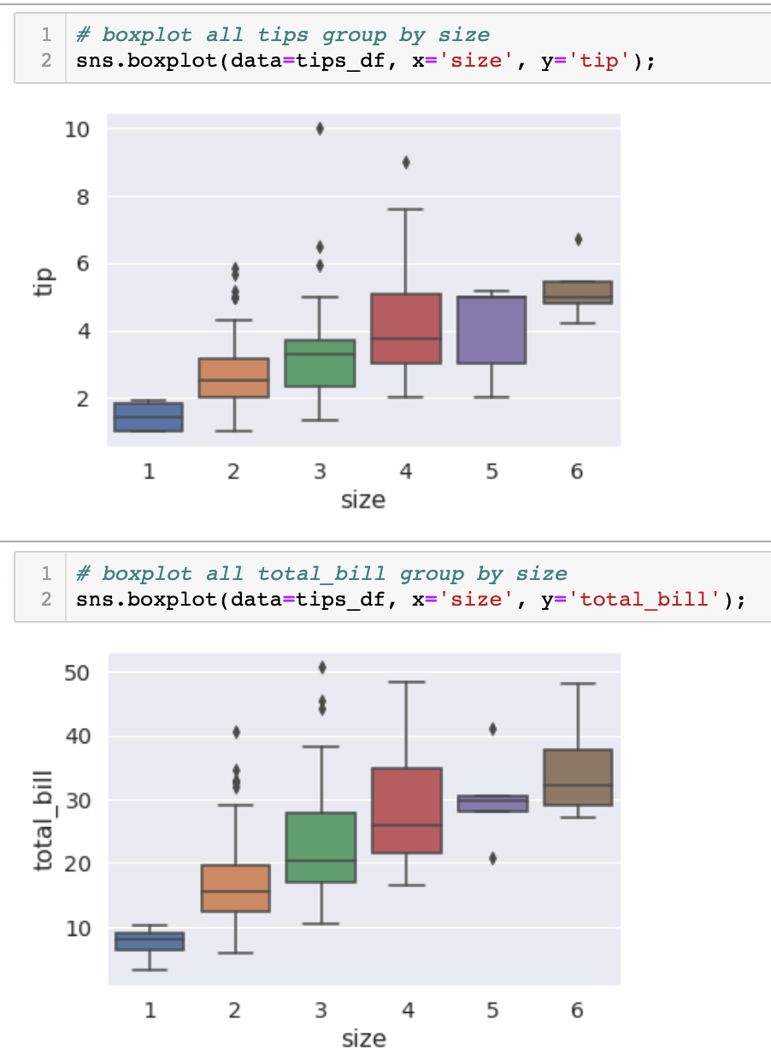
BoxPlot

Slide 14
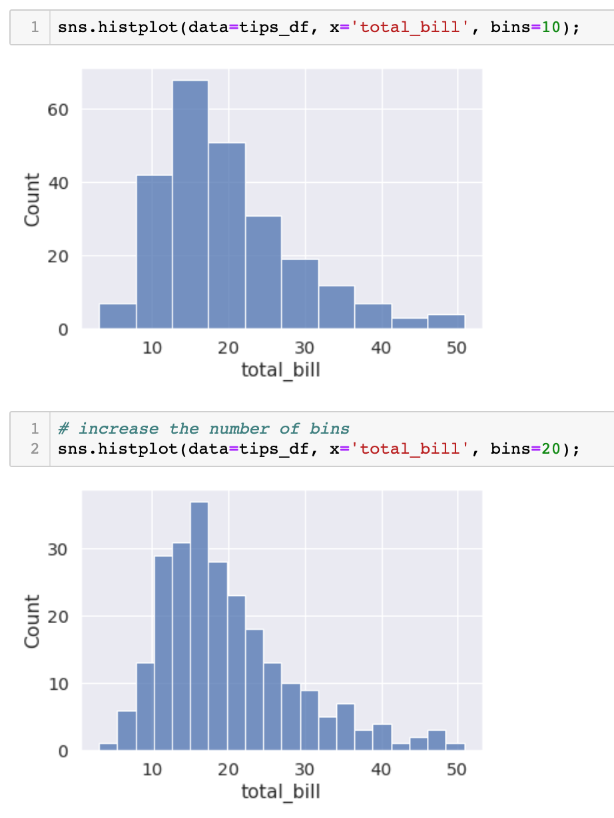
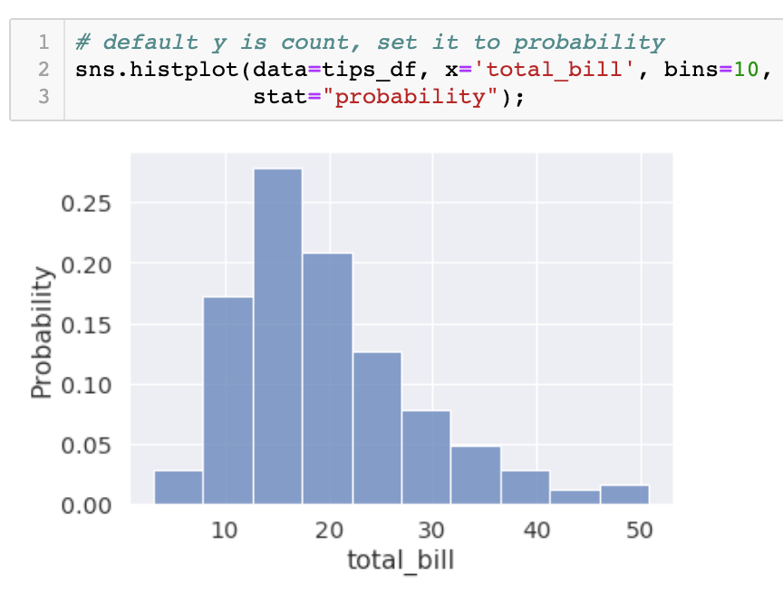
HistPlot

Slide 15
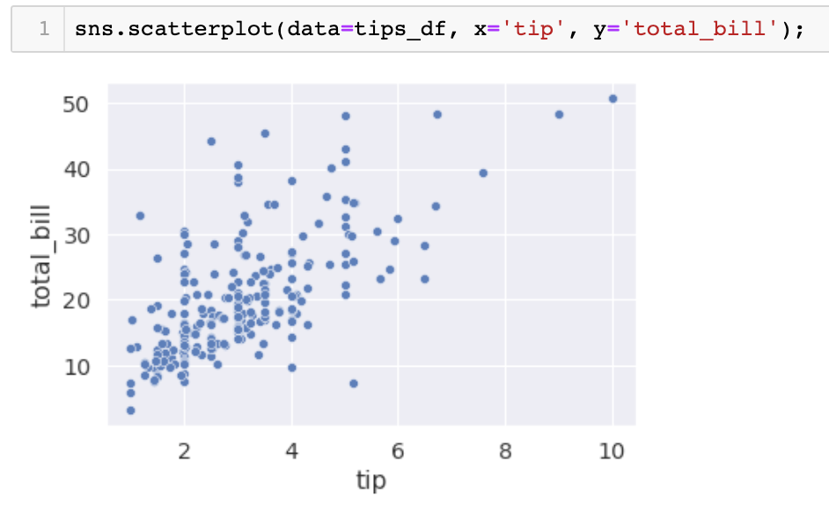
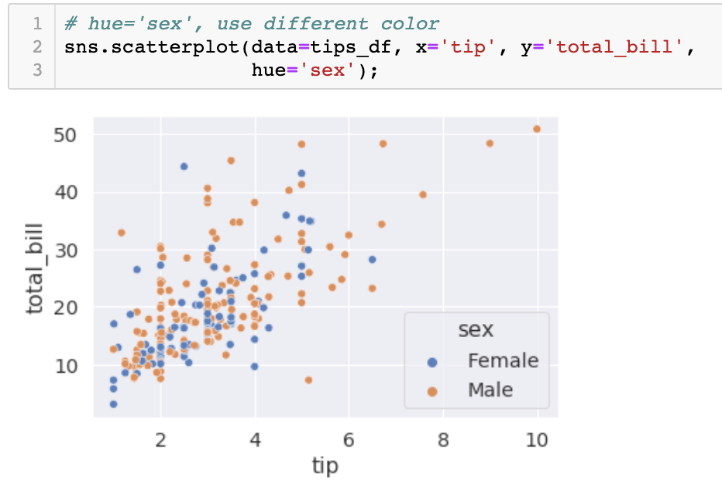
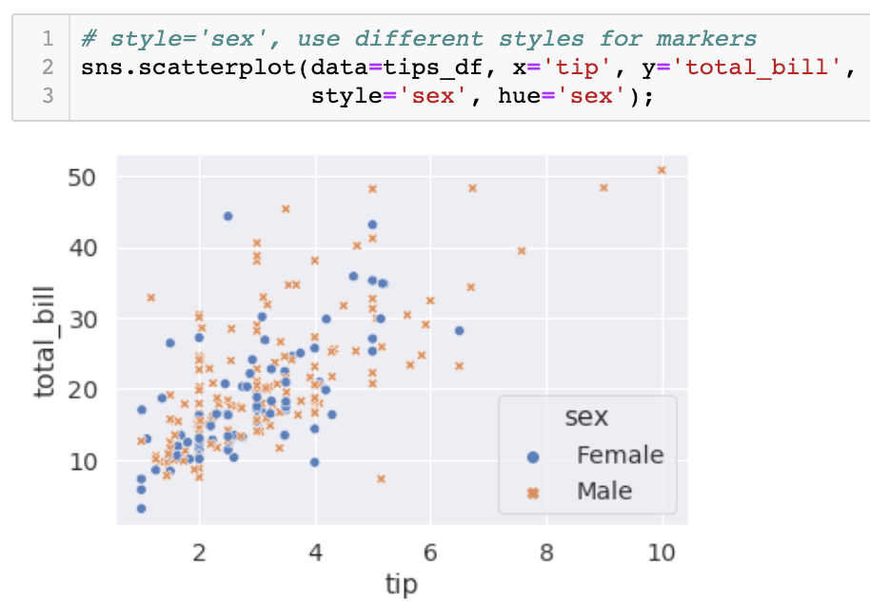
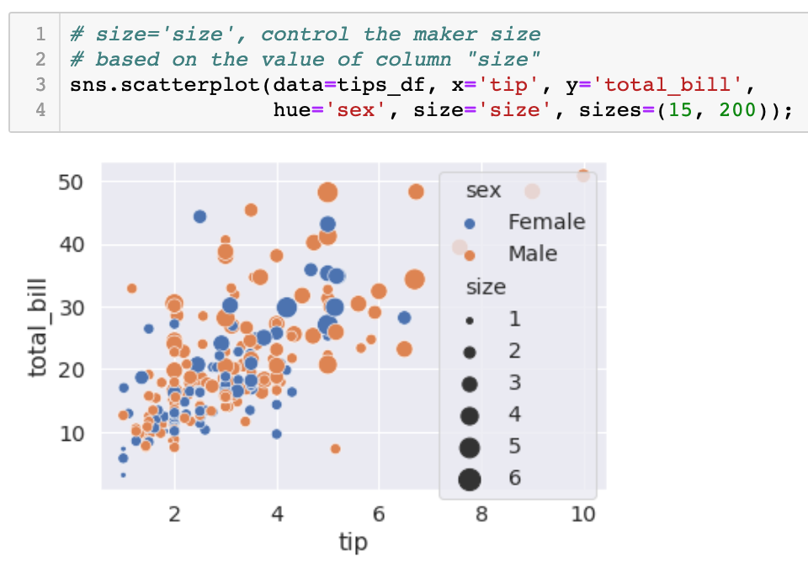
ScatterPlot

Slide 16
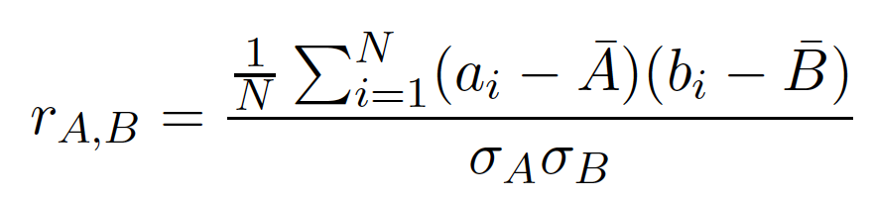
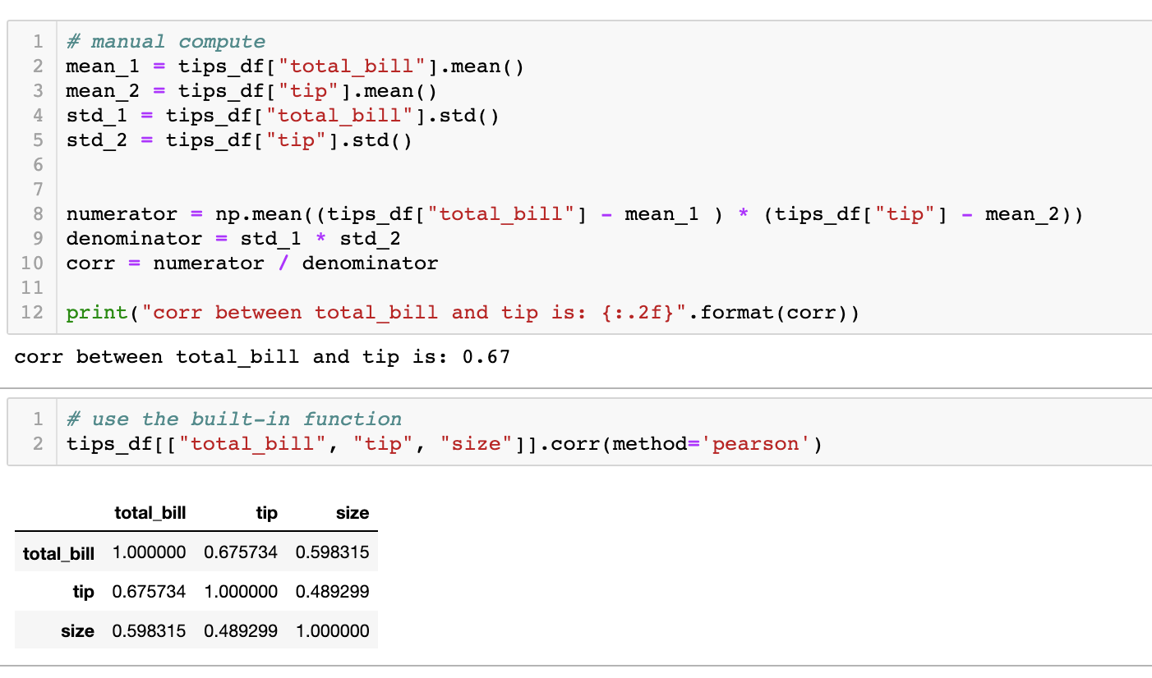
Correlation Coefficient

Slide 17

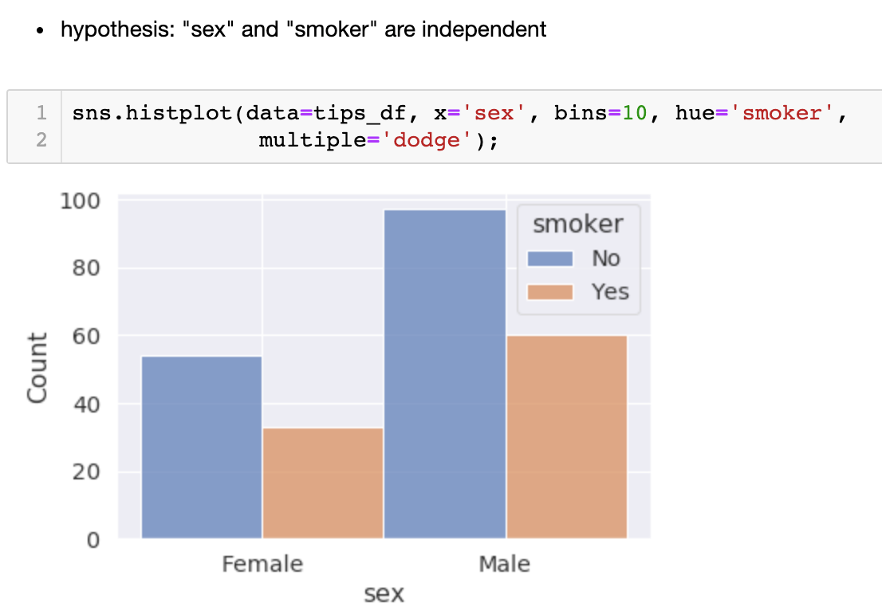
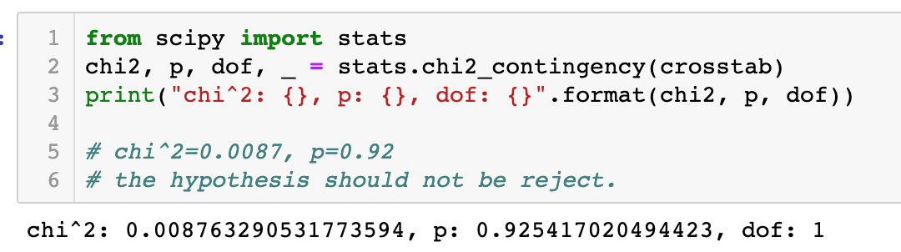

Slide 18
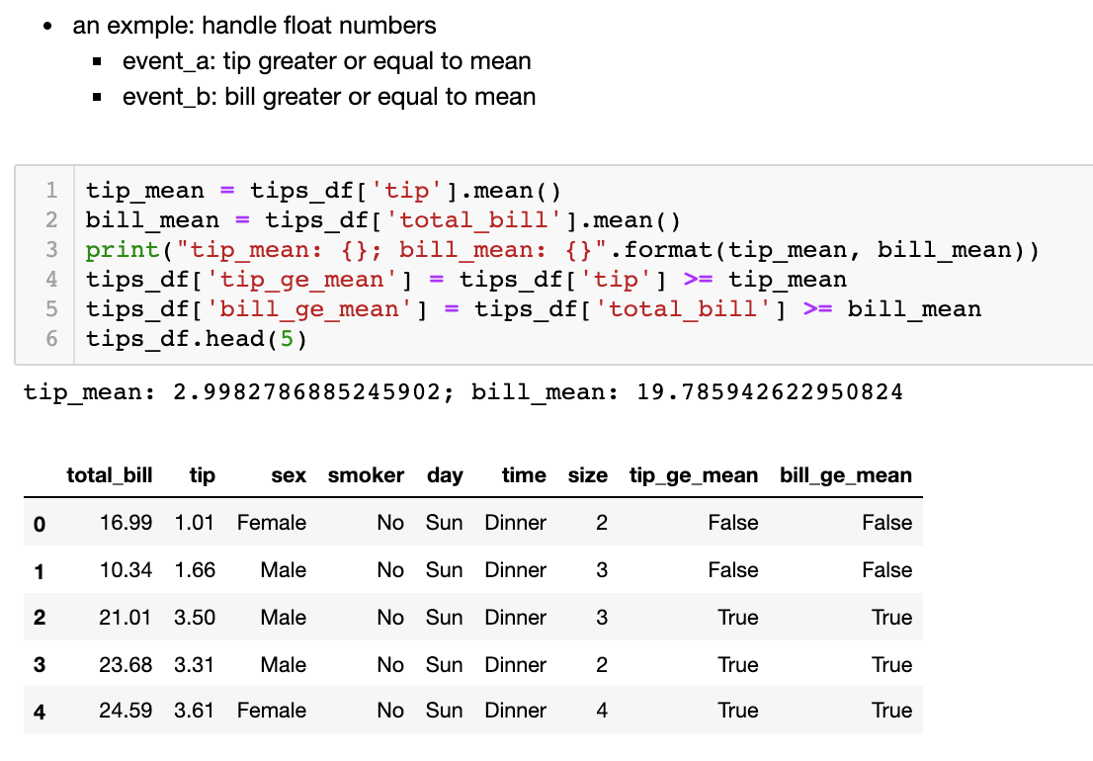
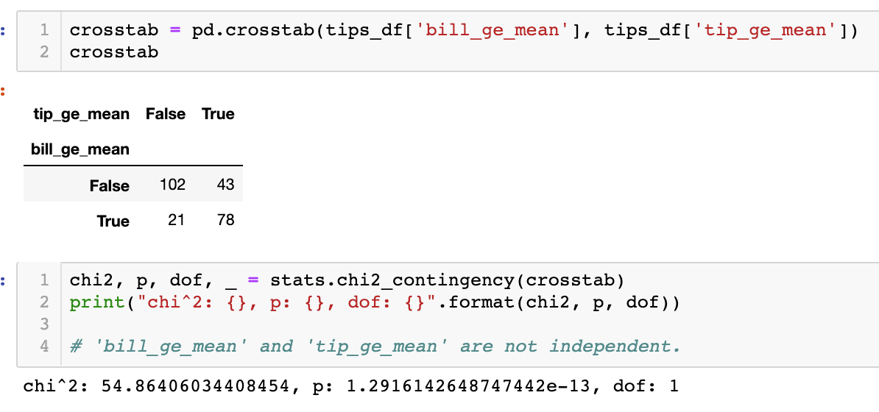
Hypothesis Testing: handle float values

Slide 19

Data Transformation (Normalization and Discretization)

Slide 20
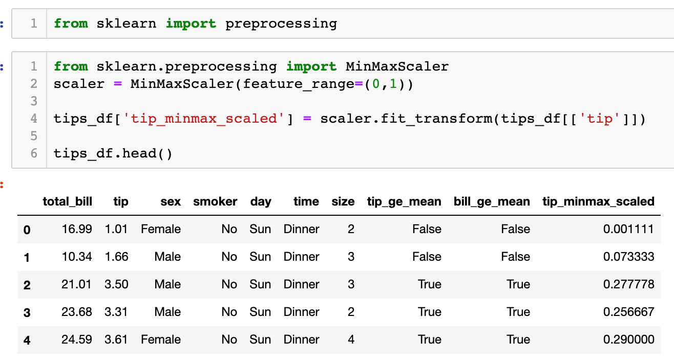
Min-Max Normalization

Slide 21
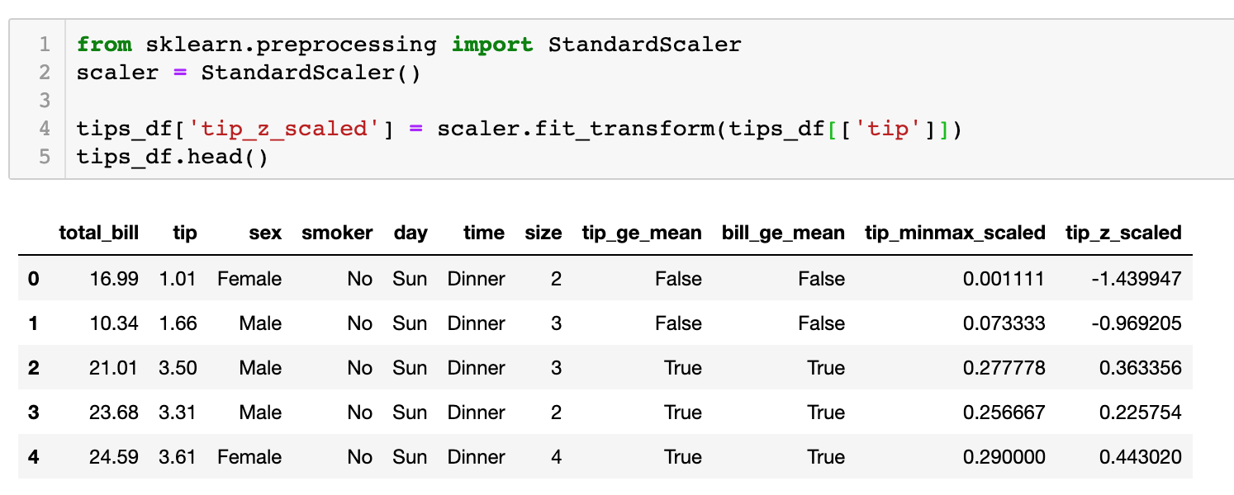
Z-Score Normalization

Slide 22
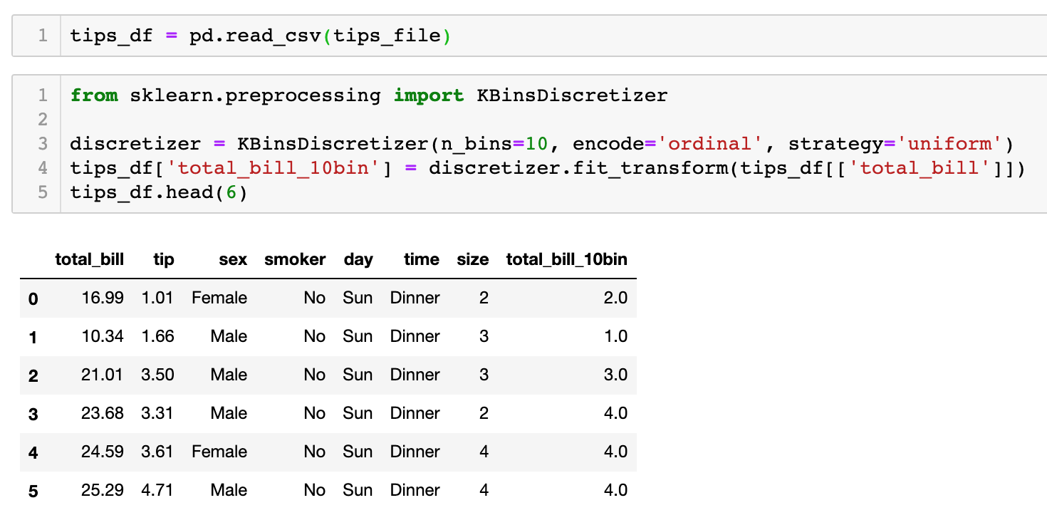
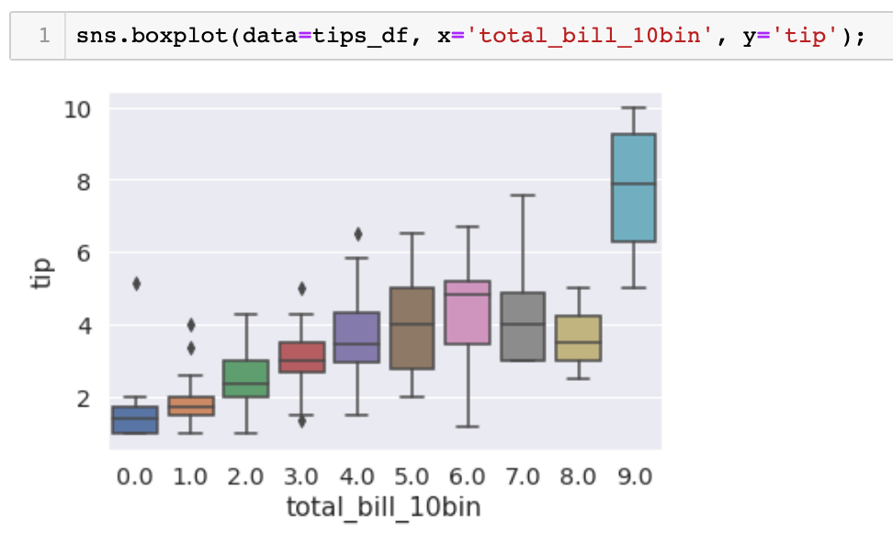
KBinsDiscretizer

Slide 23
Thanks!

